Slide 1
Keeping a streaming SVD numerically trustworthy
NUMERICAL LINEAR ALGEBRA · ROLE 2
Floating-point error, orthogonality drift, and our adaptive trigger
Based on M. Brand, Fast low-rank modifications of the thin SVD (2006)
Notes:
Introduce yourself and your part. Say: my part is numerical stability. Brand's paper gives a fast way to keep an SVD of a video stream, updating it one frame at a time. My job was to ask what floating-point arithmetic does to that algorithm over thousands of frames, and to build the trigger that keeps it accurate. Roadmap: first the setting, then where error enters, then our trigger and the results.

Slide 2

The setting: each video frame becomes one column
228 × 228
one gray frame
flattened into 51,984 numbers
matrix X: one column per frame
Columns arrive one at a time. Old frames are never stored.
Role 2 · Numerical stability · 2 / 13
Notes:
Explain the input in plain words. A video frame is a picture of 228 by 228 pixels. We flatten it into one long column of 51,984 numbers. Put the columns side by side and you get the data matrix X, with one column for every frame. The important point: frames arrive one at a time, so the algorithm sees a new column, updates its summary, and throws the frame away. That is why it is fast, but it also means small numerical errors are never washed out by recomputing from scratch.

Slide 3
What the algorithm keeps in memory
X ≈ U · U′ · S · V′ᵀ · Vᵀ
U
V
p × r
q × r
U′
S
V′
r × r
r × r
r × r
Only the small matrices are rotated. The tall ones only grow.
p = pixels per frame (51,984) · q = frames so far · r = rank kept (8 to 10)
Role 2 · Numerical stability · 3 / 13
Notes:
This is the key idea of Brand's paper. Instead of storing the full SVD, we keep five factors. U and V are tall: U has one row per pixel, V has one row per frame. The three small matrices U-prime, S and V-prime are only r by r, where r is the rank, about 8 to 10 in our demos. All the rotations that make the singular values line up are folded into the small matrices, so the expensive tall matrices are never rotated. That is the source of the speed. It is also the source of my topic: the true left vectors are U times U-prime, so both need to stay orthonormal, and every frame multiplies U-prime by another rotation.

Slide 4
One update, step by step
Amber marks the two places where floating-point error enters.
1
2
3
4
5
Split the new frame
Build a small matrix
Diagonalize K
Fold in the rotations
Append
Givens rotations give two small rotations, C and D.
A new column to U, a new row to V.
The part inside the subspace (m) and a leftover (p).
K is only (r + 1) × (r + 1).
Multiplied into the small U′ and V′ only.
roundoff enters
roundoff enters
Role 2 · Numerical stability · 4 / 13
Notes:
Walk through the five steps. Step 1: the new frame a is split. The part inside the current subspace is described by m, the coordinates, and what is left over is p. Step 2: we put the singular values and these pieces into a small matrix K. Step 3: K is diagonalized with Givens rotations; that is my teammate's part. Step 4: the two rotations are multiplied into the small matrices U-prime and V-prime. Step 5: the new direction is added to U and a new row to V. The two amber steps are where my work starts: step 1 because p is orthogonal to U only in exact arithmetic, and step 4 because we multiply a new rotation into U-prime on every frame.

Slide 5
Where orthogonality quietly breaks
In exact arithmetic U, U′ and V′⁻¹ stay perfect forever. In a computer they do not.
1. The leftover p
2. Repeated rotations
3. The inverse Vi
p = a − U(Uᵀa) should be orthogonal to U. It is only so up to roundoff, and the new column of U inherits the flaw.
U′ is multiplied by a fresh rotation every frame. Each product adds a tiny error, and they pile up.
Vi is carried along as the inverse of V′. It is updated separately and can slowly stop being the true inverse.
Floating-point model: fl(a ∘ b) = (a ∘ b)(1 + δ), |δ| ≤ u. u ≈ 1.1 × 10⁻¹⁶ in double precision, 6 × 10⁻⁸ in single.
Role 2 · Numerical stability · 5 / 13
Notes:
There are three places where orthogonality leaks. First, the leftover vector p is orthogonal to U only up to roundoff, and it becomes the next column of U, so the flaw is stored. Second, U-prime is multiplied by a new rotation on every frame, and each multiplication adds a small error. Third, we carry the inverse of V-prime separately, and it can drift away from the true inverse. The error model is the standard one: every operation is correct up to a relative error of at most u, the unit roundoff. In double precision u is about 1e-16, in single about 6e-8. We use single precision in the experiments because in double the drift is too small to see in a few thousand frames.

Slide 6
Each update costs about r · u. Frames add up.
Error analysis
Worst case, the drift grows roughly linearly with the number of frames. That is an upper bound, not a prediction.
Role 2 · Numerical stability · 6 / 13
Notes:
This is the error analysis in one sentence. One update does O(r) multiply-adds per entry of the small matrices, so each update introduces a relative error of roughly r times u. Over n frames, the worst-case bound grows about linearly in n. I want to be honest that this is an upper bound: real errors partly cancel, so the measured drift is usually smaller. But it tells us the direction. Without any repair the loss of orthogonality can only get worse as the video gets longer, so a long-running system needs a monitor.

Slide 7
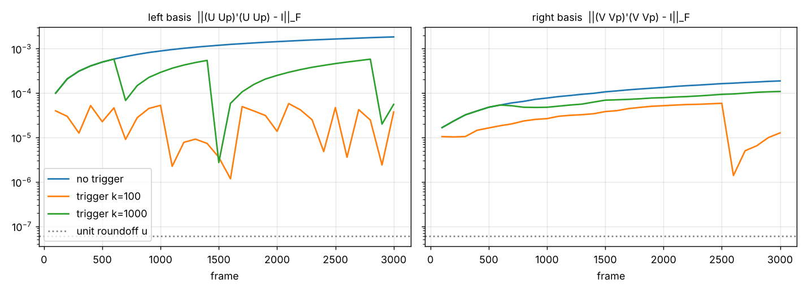
What the drift looks like in practice
1.8 × 10⁻³ without repair
3.8 × 10⁻⁵ with the trigger, 31 repairs
‖UᵀU − I‖ after 3,000 frames · single precision · 1,024 pixels · rank-8 signal · shuffled stream
Role 2 · Numerical stability · 7 / 13
Notes:
This is the experiment. Single precision, 3,000 frames of 1,024 pixels each, from a rank-8 signal, with the order of the columns shuffled. The curve that keeps climbing is the loss of orthogonality with no repair: it ends at about 1.8e-3. The flat curve is the same run with the adaptive trigger: it stays near 4e-5, and it took 31 repairs in total. Be ready for this question: why single precision? Because in double precision the drift is around 1e-13 after thousands of frames, too small to show on a slide. Single precision is also what a lot of real video hardware uses.

Slide 8
The adaptive trigger: measure cheaply, repair only when needed
Meter
Cost
Checked
‖UᵀU − I‖, running
O(pr)
every frame
‖U′ᵀU′ − I‖
O(r³)
every frame
‖V′⁻¹V′ − I‖
O(r³)
every frame
‖(VV′)ᵀ(VV′) − I‖
O(qr²)
every r frames
τ = k · r · u
Repair when any meter passes τ. k = 100 is a tuned choice, not derived.
Role 2 · Numerical stability · 8 / 13
Notes:
The trigger has two parts: meters and a threshold. The meters measure how far each factor is from orthogonal. The first one is the important one and it is cheap: we keep a running value of the drift of U, updated at O(p r) per frame, the same cost as the update itself, instead of recomputing U transpose U. The two small ones cost r cubed. The last one involves V, which is tall in the number of frames, so we check it only every r frames. The threshold is tau equals k times r times u: the per-update error is about r u, and k says how many updates of error we tolerate. I chose k equal to 100 by experiment. I should say clearly that it is a tuned value, not a derived one.

Slide 9
The repair: re-orthogonalize without changing the matrix
1
2
3
4
Modified Gram–Schmidt on U
Fold R into U′
Refactor the small part
Same for V
U′ ← R · U′, so Q · U′ equals the old U · U′.
Re-orthogonalize U′ and re-sync Vi as its true inverse.
Only when its own meter fires, checked every r frames.
U = Q · R, with Q orthonormal and R close to I.
The represented matrix is unchanged. Only its factors are cleaned.
Inside the projection a second pass is added when ‖p‖ < 0.7071 ‖a‖ (the “twice is enough” rule).
Role 2 · Numerical stability · 9 / 13
Notes:
When the trigger fires, the repair has to fix the factors without changing what they represent. Step 1: modified Gram-Schmidt on U gives an orthonormal Q and a triangular R that is very close to the identity. Step 2: instead of throwing R away, we multiply it into U-prime. Then Q times the new U-prime equals the old U times the old U-prime, so the represented matrix is unchanged. Step 3: the small matrices are refactored and Vi is rebuilt as the true inverse of V-prime. Step 4: V gets the same treatment, but only when its own meter fires. I wrote a test that checks the matrix before and after repair. Separately, when projecting a new frame, if most of it is removed (the leftover is under 0.7071 of its length) we project a second time. This is the twice is enough rule.

Slide 10
Results: the trigger buys orthogonality, not accuracy
Setting
U drift
V drift
Repairs
No trigger
1.84 × 10⁻³
1.87 × 10⁻⁴
0
k = 100
3.75 × 10⁻⁵
1.27 × 10⁻⁵
31
k = 1000
5.55 × 10⁻⁵
1.09 × 10⁻⁴
3
Singular values match the batch SVD to about 3 × 10⁻⁴ in every row, repaired or not.
Single precision · 3,000 frames · 1,024 pixels · rank-8 signal · shuffled stream
Role 2 · Numerical stability · 10 / 13
Notes:
Three runs on the same data. Without the trigger the U drift is 1.8e-3. With k equal to 100 it drops to 3.8e-5, a factor of about 50, for 31 repairs over 3,000 frames. With k equal to 1000 we repair only 3 times and U is nearly as good, but V is noticeably worse, so k of 100 is a safer middle. Important and honest point: the singular values agree with the batch SVD to about 3e-4 in all three rows. So the repair keeps the factors orthogonal, which matters for anything built on them, but it does not make the singular values more accurate here. If the professor asks why bother, the answer is that downstream steps like projection and background subtraction assume U is orthonormal.

Slide 11
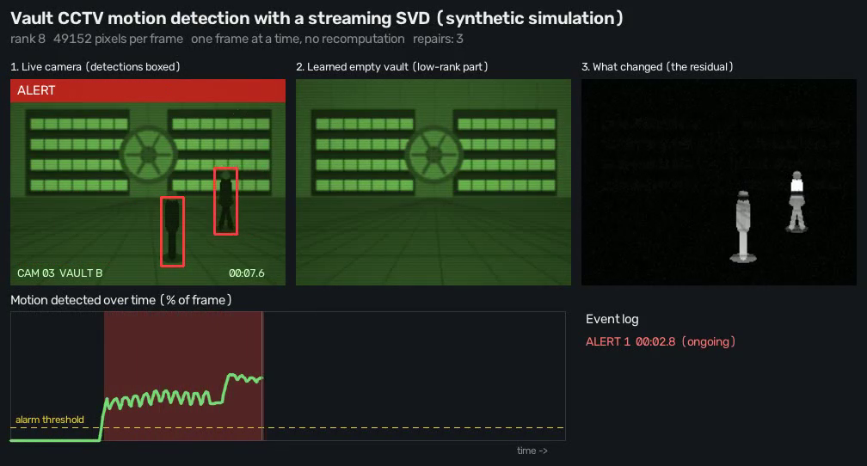
Application: spotting movement in vault CCTV
Background = U(Uᵀa), the part the subspace explains.
Foreground = |a − background|, what moved.
Synthetic simulation, not real footage · 420 frames · 256 × 192 · rank 8 · stability keeps the background clean
Role 2 · Numerical stability · 11 / 13
Notes:
This is the application. Each frame is projected onto the learned subspace; what the subspace explains is the static background, and the difference is the foreground, meaning the moving person. I want to be clear that this is a synthetic simulation I generated, not real CCTV footage. Why does my topic matter here? Background subtraction uses U times U-transpose-a. If U drifts from orthonormal, that projection is no longer a true projection and the background picks up ghosts of the foreground. Keeping U orthonormal is what keeps the foreground map clean over a long recording.

Slide 12
Honest limits
Order matters
Frozen background
Tuned, not derived
Truncation to rank r is greedy. A drifting stream gave error about 695 against 17 for the batch SVD. Shuffled, it was 26.7.
After rank r is reached the subspace stops growing. A permanent scene change stays flagged as foreground.
k = 100 came from experiments. In double precision the drift is small, so single precision was used to show it.
Role 2 · Numerical stability · 12 / 13
Notes:
Be upfront about the limits; it makes the rest more believable. First, the algorithm truncates greedily, so the order of the frames matters. On a stream that drifts steadily, the reconstruction error was about 695 against 17 for the batch SVD; on a shuffled stream it was 26.7. This is the limitation the paper itself notes, and it is not caused by roundoff. Second, in my implementation the subspace is frozen once the rank cap is reached, so a stopped object is not absorbed into the background and a permanent change in the scene stays flagged. Third, k equal to 100 is tuned, not proven, and I used single precision because double precision hides the drift in short runs.

Slide 13
Fast updates need a watchdog.
Takeaways
Roundoff makes the factors drift, roughly r · u per update.
Cheap meters watch it. A repair runs only when τ is crossed.
Result: drift down about 50 times, with 31 repairs in 3,000 frames.
Role 2 · Numerical stability · 13 / 13
Notes:
Close with three sentences. One: roundoff makes the factors lose orthogonality, about r times u per update. Two: cheap meters watch for it and a repair runs only when the threshold is crossed, and the repair does not change the matrix. Three: in the experiment this cut the drift about fifty times with 31 repairs in 3,000 frames. Then hand over to questions. Likely ones: why k equal to 100, why single precision, and why the singular values do not improve. The answers are on slides 8, 7 and 10.

